Slide 1
INTRODUCTION TO HTML
Andrij Lymych

Slide 2
AGENDA
History
What is HTML?
Doctype
HTML document
Tags
Attributes
Nesting
Group of tags
HTML5 new features
Deprecation

Slide 3

HISTORY
Tim Berners-Lee presented HTML
in 1992 .
He is “father of the Web” and this was the beginning of the Web.

Slide 4
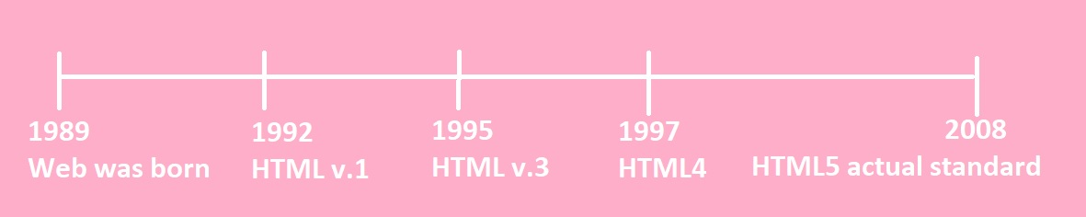
HISTORY TIMELINE
HTML (no version number, November 3, 1992): The first text-only version
HTML 2.0 (November 1995): RFC 1866 version with form support. The status of this standard is already "historic", and previous versions are also considered obsolete.
HTML 3.0: A version that has not been distributed since this standard was obsolete with the release of Netscape Navigator version 3.
HTML 4.0 (December 18, 1997): Style sheets, scripts, and frames have been added. There was also a division into Strict (strict adherence to standards), Frameset (with frame support), Transitional (transitional). A revised version of this standard was released on April 24, 1998.
HTML 5 (Working Draft, April 5, 2008): [10] HTML 5 has a new dictionary based on HTML 4.01 and XHTML 1.0. The HTML-related DOM specification has also been redesigned and expanded.

Slide 5
WHAT IS HTML?
HTML stands for Hyper Text Markup Language
HTML is the standard markup language for creating Web pages
HTML describes the structure of a Web page
HTML consists of a series of elements
HTML elements tell the browser how to display the content
HTML elements label pieces of content such as "this is a heading", "this is a paragraph", "this is a link", etc.

Slide 6
DOCTYPE
A declaration found at the very top of almost every HTML document
Specifies the language or rules the page uses
In HTML, the DOCTYPE is case insensitive. The following DOCTYPEs are all valid:
<!doctype html>
<!DOCTYPE html>
<!DOCTYPE HTML>
<!DoCtYpE hTmL>

Slide 7

HTML DOCUMENT
HTML document is a text document created to represent formatted information including text, video, images, sounds
HTML document is created by tags and consists of sections
<!doctype html> <html lang="en"> <head> <meta charset="utf-8"> <title>Sample website</title> </head> <body> <p>Hello World!</p> </body> </html>

Slide 8
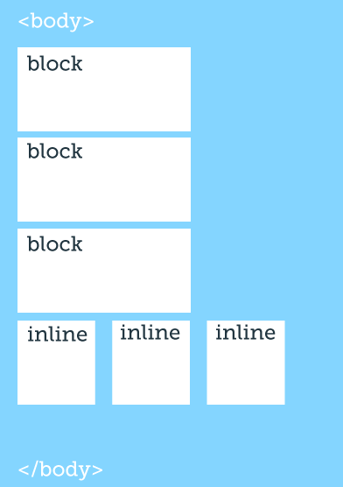
TYPE OF TAGS : BLOCK vs. INLINE

Slide 9
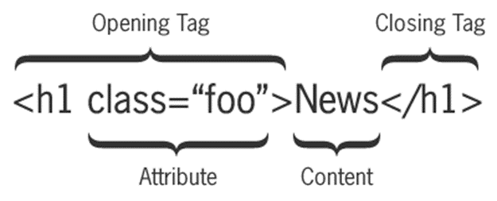
TAG PAIRS
Tags are keywords that determine structure of an HTML page
Keyword is surrounded by angled brackets
Most tags come in pairs
Opening or start tag
Closing or end tag
<h1>Pet Care 101</h1>
Closing tag must have same case as opening tag

Slide 10
ATTRIBUTES
Modifiers of HTML elements that provide additional information
Are extensions of elements
Syntax: <tag attribute="value">

Slide 11
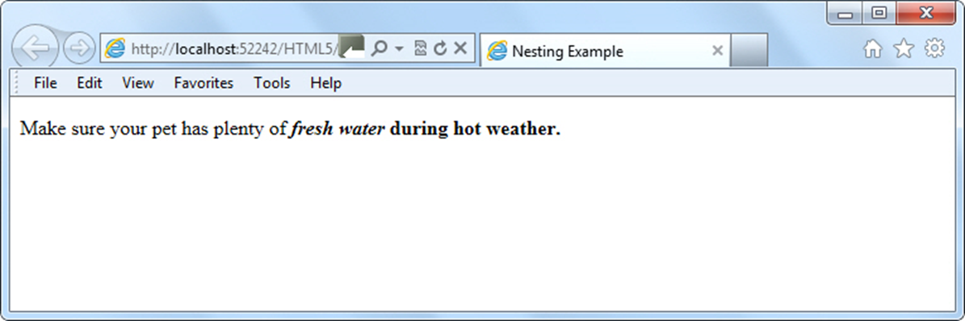
NESTING
To place one element inside another
Example:
<p>Make sure your pet has plenty of <i><b>fresh water</i> during hot weather.</b></p>

Slide 12
GROUP OF TAGS
Text Formatting
<h?> ... </h?> Heading (?= 1 for largest to 6 for smallest, eg h1)
<b> ... </b> Bold Text
<i> ... </i> Italic Text
<u> ... </u> Underline Text

Slide 13
GROUP OF TAGS
Section Divisions
<div> ... </div>
<span> ... </span> Section of text within other content
<p> ... </p> Paragraph of Text
<br> Line Break
<hr> Basic Horizontal Line

Slide 14
GROUP OF TAGS
Lists
<ol> ... </ol> Ordered List
<ul> ... </ul> Un-ordered List
<li> ... </li> List Item (within ordered or unordered)
<ol type="?"> Ordered list type: A, a, I, i, 1
<ol start="??"> Ordered list starting value
<ul type="?"> Unordered list bullet type: disc, circle, square
<li value="??"> List Item Value (changes current and subsequent items)

Slide 15
GROUP OF TAGS
Images
<img src="url" alt="text">
<img> Tag Attributes:
src="url" URL or filename of image (required!)
alt="text" Alternate Text (required!)
width="??" Image width (in pixels or %)
height="??" Image height (in pixels or %)
border="??" Border thickness (in pixels) (*)

Slide 16
GROUP OF TAGS
Linking Tags
<a href="url"> link text </a> Basic Link
<a> Tag Attributes:
href="url" Location (url) of page to link to.
name="??" Name of link (name of anchor, or name of bookmark)
href="url#bookmark“ Link to a bookmark (defined with name attribute).
href="mailto:email" Link which initiates an email (dependant on user's email client).

Slide 17
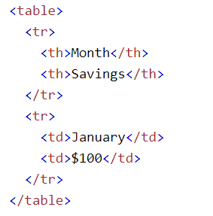
GROUP OF TAGS
Tables

Slide 18
GROUP OF TAGS
Forms
<form> ... </form>
<form> Tag Attributes:
action=“/auth" The action attribute defines the action to be performed when the form is submitted.
method=“POST“ The method attribute specifies the HTTP method to be used when submitting the form data.

Slide 19
GROUP OF TAGS
Inputs
<input> ... </input> Input field within form
<input> Tag Attributes:
type="***" Input Field Type: text, password, checkbox, submit .
name="***" Form Field Name (for form processing script)
value="***" Value of Input Field

Slide 20
GROUP OF TAGS
<select> ... </select> Select options from drop down list
<select> Tag Attributes:
name="***"Drop Down Combo-Box Name (for form processing script)
size="?" Number of selectable options
<option> ... </option> Option (item) within drop down list
<option> Tag Attributes:
value="***"Option Value
<textarea> ... </textarea> Large area for text input
<textarea> Tag Attributes:
name="***"Text Area Name
rows="?" Number of rows of text shown
cols="?" Number of columns (characters per rows)

Slide 21
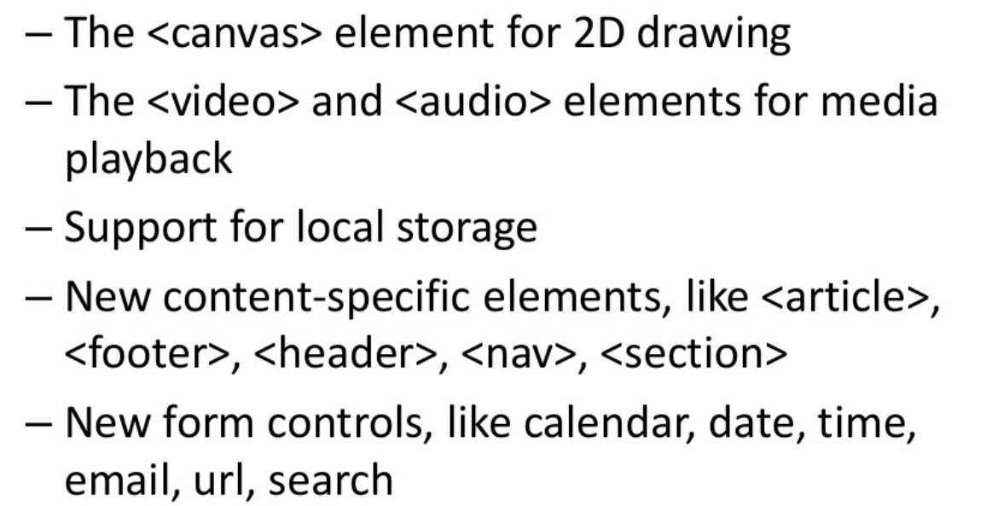
HTML5 NEW FEATURES

Slide 22
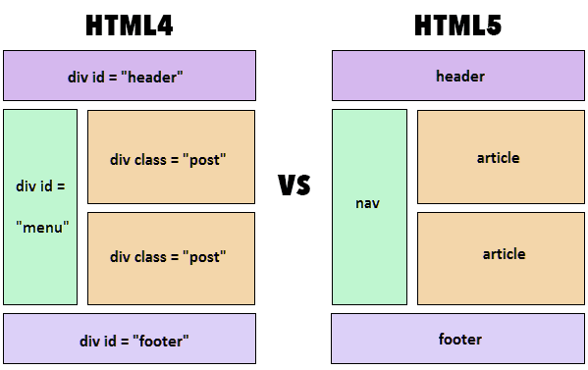
HTML5 NEW FEATURES

Slide 23
DEPRECATION
While new elements become available, the W3C earmarks other elements for eventual removal because their functionality is no longer useful.
Removing elements from the list of available HTML elements is referred to as deprecation.
Note: The same thing applies to attributes and CSS properties.

Slide 24
EXAMPLES OF DEPRECATED HTML ELEMENTS
<big>: Makes text bigger relative to the current font size
<center>: Center-aligns text and content
The fix: Use CSS instead

Slide 25
Thank you for your attention
By Andrii Lymych

Slide 26


